Slide 1

CICS Introduction & RDO
IBM ISSCDL Software Co., Ltd.
2004/08/01

Slide 2
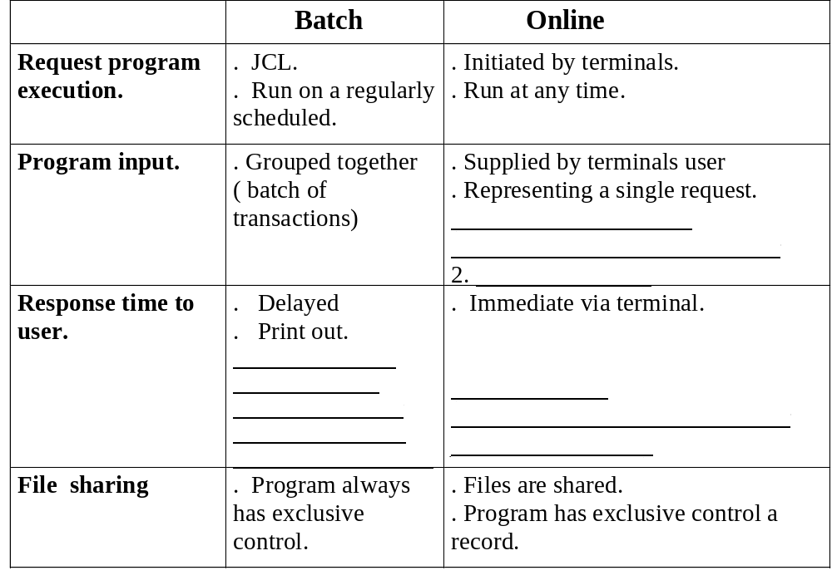
Introduction to Online Systems

Slide 3
What is CICS? (1)
The Customer Information Control System/Virtual Storage (hereafter called simply CICS) is an IBM product that handles online applications. It acts as an interface between the operating system (MVS) and your application programs. It can be viewed as the software interface between terminal users and online application program.

Slide 4
What is CICS? (1)
应用程序
应用程序
CICS
操作系统
Database
Files

Slide 5
What is CICS? (2)
CICS Region
Management Modules
Application
programs
Control
tables

Slide 6
What is CICS? (3)
Initiating Application programs
Terminal Communications
File Processing
CICS Components

Slide 7
Initiating Application programs
What is CICS? (3)
In CICS terminology, a transaction is the basic unit of processing started by a single user request. A CICS transaction may require the execution of one or more related programs that function together. The terminal user initiates a transaction by entering its transaction ID.

Slide 8
Terminal Communications
What is CICS? (3)
CICS ‘remember’ which terminals are accessing which programs, thereby acting as a manager of all terminals.

Slide 9
File Processing
What is CICS? (3)
CICS provides the management necessary to give programs exclusive control of records during an update operation. CICS also provides journalizing facilities that can be used to record changes made to files, and back-out facilities that can be used to cancel changes made to files.

Slide 10
CICS Components
What is CICS? (3)
1. Management Modules.
2. Control Tables.
3. Control Blocks.

Slide 11
Management Modules
  任务管理（tasK Control Program）
  终端管理（Terminal Control Program）
  时间管理（Interval Control Program）
  文件管理（File Control Program）
  存储管理（Storage Control Program）
  程序管理（Program Control Program）
  临时存储管理（Temporary Storage Program)
  瞬间数据管理（Transient Data Control Program)

Slide 12
任务管理
Management Modules
控制CICS内部CPU的使用
建立任务
实现多个任务的并发执行

Slide 13
终端管理
Management Modules
提供终端与应用程序之间的通信
具有最高优先权的任务，当CICS启动时，立即执行，等待接收终端上的输入
通过终端控制表TCT及VTAM、BTAM来控制通信和终端

Slide 14
时间管理
Management Modules
提供日时钟，定时器
检测长时间运行任务
限制CICS空载时间
启动与时间有关的任务
在制定的时间间隔后产生信息

Slide 15
文件管理
Management Modules
联机访问数据文件
使用DAM、ISAM、VSAM等标准存取方法获取I/O区及读写数据
在CICS启动时自动打开文件控制表FCT中的所有文件
在CICS结束时自动关闭所有文件
应用程序无需打开/关闭文件

Slide 16
存储管理
Management Modules
控制CICS系统及应用程序使用的虚存
静态存储区：启动分配，保留到CICS结束
动态存储区：根据请求来分配和释放

Slide 17
程序管理
Management Modules
确定程序位置
加载程序到CICS分区
交易启动时，KCP在程序控制表中查找程序名，在处理程序表PPT中查找程序的位置，请求系统将程序装入CICS分区

Slide 18
临时存储管理
Management Modules
CICS中的存储区、VSAM
按应用请求来获得或释放
属于动态存储区

Slide 19
瞬时数据管理
Management Modules
在DCT中定义
内分区：联机交易产生，在DCT中作为“目的地”定义
外分区：批处理程序产生，在DCT中作为文件定义

Slide 20
系统控制表
Control Tables
由管理模块使用，定义CICS的系统环境
CICS启动时建立，并保留到CICS结束
部分表可以联机修改

Slide 21
系统控制表
Control Tables
SIT: System Initiazation Table
TCT: Terminal Control Table
PCT: Program Control Table
PPT: Processing Program Table
FCT: File Control Table
DCT: Destination Control Table
ACT: Application Control Table

Slide 22
PCT-Program Control Table
Control Tables
标示和启动交易所需的控制信息
  Transaction ID
  程序名称

Slide 23
PPT-Processing Program Table
Control Tables
在CICS中运行的程序定义
  程序名称
  MAP名称
  程序语言
  程序是否驻留

Slide 24
FCT-File Control Table
Control Tables
联机文件信息定义
  文件名
  存取方式
  文件结构
  记录格式
  处理要求

Slide 25
系统控制块
Control Blocks
CSA: Common System Area
TCA: Task Control Area
TWA: Transaction Work Area
TIOA: Terminal Input/Output Area
EIB: EXEC Interface Block

Slide 26
EIB
Control Blocks
存放EXEC CICS 和与EXEC 指令有关的信息，系统把它作成一个COPYBOOK
Transaction ID
启动日期和时间
光标位置

Slide 27
The role of CICS in an Online Environment
CICS and Application Program
CICS and Operating System

Slide 28
CICS and Application Program
1, The execution of programs
2, Requesting CICS services
3, CICS Dispatching
4, The loading of programs

Slide 29
1. The execution of programs
Transaction ID Programs
CICS searches for and transfers control to the specified program module.
In the process of initiating a transaction CICS creates a task. To CICS, each task represents a unit of work.
CICS allows more than one terminal user to use the same transaction at the same time

Slide 30
E. CICS 应用程序的执行过程
1. Enter Transaction ID
2. Put into terminal buffer
3. CICS对Transaction ID 进行确认
4. Create task
5. Load 相应的应用程序
6. Process the input data
7. CICS将处理结果返回terminal
8. Transaction End

Slide 31
2. Requesting CICS services
  CICS programs must make these requests from CICS, not OS
  All terminal communication, file I/O, and other operating system services must be request using CICS facilities

Slide 32
3. CICS Dispatching (1)
Dispatching is the process where CICS gives control to the application program associated with a task, allowing that program to perform its designated processing. It is important to remember that CICS dispatched tasks, not programs

Slide 33
3. CICS Dispatching (2)
Once dispatched, a task run until it issues another CICS command or it terminates. Usually, a dispatched task will issue another command within a very short time.
For example, I/O operation, which causes the task to give up control. The execution of the task is interrupted to allow time for the I/O operation to complete. In the interim, CICS will attempt to locate another ready task and dispatch it.
The dispatching process repeats, over and over, for all tasks. In this manner, CICS handles the concurrent execution of multiple tasks. ------ Multitasking.

Slide 34
4. The loading of programs (1)
Multi-threading: Both users use the same copy.
Keep the copy in virtual storage.
Reentrant: A reentrant program is one that does not store data within itself or modify itself in any way during execution

Slide 35
4. The loading of programs (2)
CICS Region
Search Library
Program
Requests
Program Management Module
B
Load Program B
A
Application
Program
B
Load Program A
Application
Program
A
Application
program
Libraries

Slide 36
CICS and Operating System (1)
a. CICS is submitted to the operation system as a batch job. CICS has often likened to a small operating system: dispatching its own work, while itself under the control of a larger operating system.
b. MRO (Multi-region Operation)
  MRO allows multiple CICS regions running within the same processor to communicate with each other.

Slide 37
CICS and Operating System (2)
c. CICS services and Operating System


CICS Region
Communications
System Access
Methods
(VTAM, etc.)
File Access
Methods
(VSAM, etc.)
CICS Management Modules
.
.
CICS
Command
.
.
CICS
COMMAND
.
CICS
COMMAND
.
.
CICS
Command
.
.
Terminals
Data
Files

Slide 38
CICS Services
In online environment:
  The online programs are executing concurrently.
  All under the control of CICS
The online programs issue requests to CICS to handle such functions as interprogram communication and file access.
CICS management modules provide the interface between CICS application programs and the operating system.
Basic Facilities
Additional Facilities

Slide 39
Basic Facilities (1)
1. Program Control
  Program Control is responsible for managing the use of all application programs
  There are three methods by which CICS application programs are invoked:
    .Task initiation. (PPT: Processing Program Table)
    . Linking from one program to another program.
    .Transferring control from one program to another.
  Program terminate.
    .Normal terminates.
    .Abend request.
    .Errors occur. (Don't supply the operation when the error is appearing.)

Slide 40
Basic Facilities (2)
Terminal Management
  Terminal Management is the CICS service responsible for the communication between a terminal and an application program.
    .Send data to a terminal. (TCT: Terminal Control Table)
    .Receiving data from a terminal.
    .Implementing a conversation.

Slide 41
Basic Facilities (3)
File Control (FCT: File Control Table)
  CICS application programs access data by issuing input and output requests that are interpreted and processed by standard file access methods and data base management routines.
    Exclusive file.
    For example: file operation: Browse
      .start browse command
      .read next command
      .read previous record command
      .reset browse command
      .end browse

Slide 42
Basic Facilities (4)
BMS (Basic Mapping Support)
  Basic Mapping Support provides a sophisticated interface between the application program and the terminal
    BMS map generation:
      .Physical map: contains all the information needed by Basic Support to format and display map data on a particular terminal.
      Symbolic map: describes the fields that are to be processed by the application program. BMS uses the symbolic map for presenting user-entered data to the program for processing, or for receiving data from the program for display

Slide 43
Additional Facilities
Storage Control
  It is responsible for dispatching and managing the storage for each task.
Task Control
  It is responsible for initializing and controlling the execution of the task.
  Terminal management→ TRANS ID → Task control → valid available → PCT → create task
Temporary Storage.
  It is responsible for managing temporary data: save input data of multiplscreen & save the data that is used for next task.
    Queue
    It is defined by application program.
Transient Data
  Queue: Intrapartition Transient Data Queue & Extrapartition Transient Data Queue
  It is defined outside of the program: Destination Control Table
Internal Control
  It is responsible for controlling time-based events in the CICS system
  Interval Control can also be used to initiate a transaction from within an application program.
  A program can request that its processing be delayed for a specified interval or until a
  specified time of day.
  A program can also request that it be notified when a given time interval has expired or a
  specified time of day has been reached

Slide 44
CICS RESOURCE
DEFINITION
Resource definition--an introduction
Before you can use CICS, you must supply it with information about the resources it should use, and how it should use them. Some examples of resources are:
  _x0004_ Terminals
  _x0004_ Files
  _x0004_ Programs
  _x0004_ Journals
  _x0004_ Transactions
  _x0004_ Connections
  _x0004_ Databases
Your CICS system has to know which resources to use, what their properties are, and how they are to interact with each other.
You supply this information to CICS by using one or more of the four methods of resource definition:

Slide 45
Resource definition -- Forth methods
A. Resource definition online (RDO): This method uses the CICS-supplied online transactions CEDA, CEDB, and CEDC. Definitions are stored on the CICS system definition file (CSD), and are installed into an active CICS from the CSD.
B. DFHCSDUP offline utility: This method also stores definitions in the CSD. DFHCSDUP allows you to make changes to definitions in the CSD by means of a batch job submitted offline.
C. Automatic installation (autoinstall): Autoinstall minimizes the need for a large number of definitions, by dynamically creating new definitions based on a "model" definition provided by you.
D. Macro definition: You can use assembler macro source to define resources. Definitions are stored in assembled tables in a program library, from where they are installed during CICS initialization.

Slide 46
RESOURCES DEFINATION
Defining resources in CICS control tables
Installing map sets and partition sets
Installing application programs
Defining DL/I support
Defining DB2 support
Defining terminal resources
Defining data sets
  Defining the temporary storage data set
  Defining transient data destination data sets
  Defining data sets for journaling and archiving
  Defining the CICS system definition data set
  Defining and initializing the restart data set
  Defining and using catalog data sets
  Defining and using auxiliary trace data sets
  Defining dump data sets
  Defining the CICS availability manager data sets
  Defining user files
  DD statements for DL/I data sets
  Defining the CMAC messages data set

Slide 47
Introducing the CSD
The CICS system definition (CSD) file is a VSAM data set containing a resource definition record for every resource defined to CICS by means of CEDA or DFHCSDUP. It can be defined as recoverable, so that changes that were incomplete when an ABEND occurred will be backed out.

Slide 48
How the CSD is organized -- groups and lists
Information on the CSD is organized into groups and lists. The main purpose of the group is to provide a convenient method of collecting related resources together on the CSD. Every resource that you define must belong to a group; you cannot define a resource without also naming its group.
A list contains the names of groups that CICS installs at a cold start. You can add groups to lists if you want them to be installed at a cold start, or if it helps you to manage your groups better, but groups do not need to belong to lists, and can be defined independently.

Slide 49
CEDA
CEDA交易用来定义，修改和删除CSD文件中的定义：
  交易（Transaction）
  程序（Programs）
  文件（File）
  MAP SET
  ……

Slide 50
CEDA-显示格式
命令输入区
提示区
  ENTER COMMANDS
  OBJECT CHARACTERISTICS
  OVERTYPE TO MODIFY
信息区
相应区
PF键说明区

Slide 51
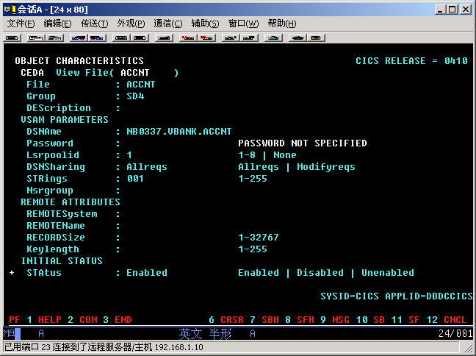
命令输入区
提示区
信息区
响应区
PF键说明区

Slide 52
续页标志

Slide 53
CEDA-资源组织形式
LIST
  GROUP
    Connection
    File
    Mapset
    PARTItionset
    PARTNer
    PROFile
    PROGram
    Sessions
    TErminal
    TRANClass
    TRANSaction

Slide 54
CEDA-命令介绍
语法规则
  “*”：代替多个任意字符
  “+”：代替一个任意字符
  当前组和当前List

Slide 55
CEDA-命令介绍
资源管理命令
  ALTER：修改资源定义
  COPY：组内或组间拷贝资源定义
  DEFINE：定义新资源
  DELETE：删除资源
  EXPAND：显示组内资源
  RENAME：重命名组内资源

Slide 56
CEDA-命令介绍
组管理命令
  CHECK：检查组内资源
  INSTALL：动态安装资源
  LOCK：对组的存取控制
  UNLOCK：对组的存取控制

Slide 57
CEDA-命令介绍
LIST管理命令
  ADD：将一个组名加到一个LIST中
  APPEND：表间拷贝
  CHECK：检查表中组的资源定义
  EXPAND：显示组名
  LOCK：对表的存取控制
  UNLOCK：对表的存取控制
  REMOVE：删除组

Slide 58
ALter | DEFine MAP SET
语法
  Alter | define
  Mapset(name)
  [Group(groupname)]
  [RSL({0|值|Public})]
  [Status({Enabled | Disabled})]
RSL：对资源的存取权限码，取值范围为0-24，public表示任何交易可存取该MAPSET

Slide 59
ALter | DEFine PROGram
语法
{alter | define}
program(name)
[group(groupname)]
[language({assembler|cobol|pli|rpg})]
[reload({no|yes})]
[resident({no|yes})]
[RSL({0|值|PUBLIC})]
[status({Enable|Disabled})]
RELOAD：程序在LINK,XCTL时是否要加载一个程序副本
RESIDENT：是否常驻内存

Slide 60
ALter | DEFine TRansaction
语法
{alter | define}
transaction(name)
[group(groupname)]
[program(name)]
[dtimeout({no|value})]
[dump({yes | no})]
[RSL({0|值|PUBLIC})]
[status({Enable|Disabled})]

Slide 61
Install
将一个指定组中的资源动态的加入到当前运行的CICS系统中
语法
  INSTALL
  [GROUP(groupname)]
  [Resourcetype(resourcename)]

Slide 62
CECI | CECS
对输入的CICS命令进行语法检查
在3278交互式执行
提供CICS命令及应用程序接口的语法参考

Slide 63
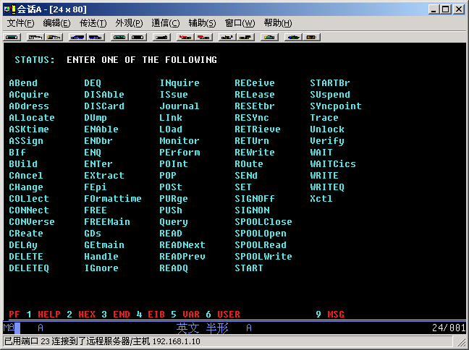

Slide 64
CECI | CECS
SAMPLE
  输入
  CECI READ DATASET('ACCNT') RIDFLD('1111111111111111') EQUAL
  输出
  如下页所示

Slide 65
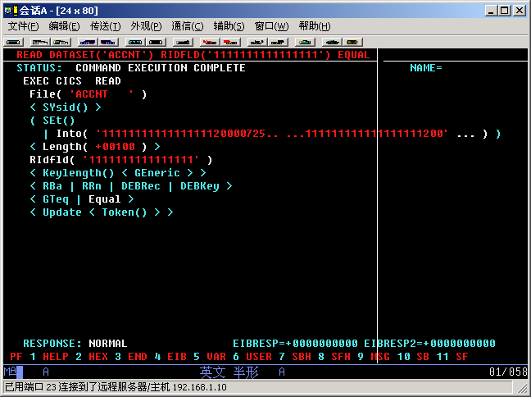

Slide 66
CEBR
浏览CICS临时存储队列中的内容

Slide 67
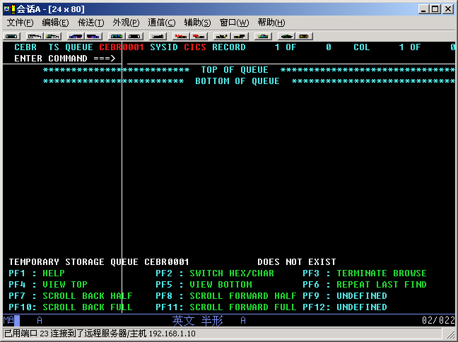

Slide 68
CEMT
显示/维护联机资源状态
终止TASK的执行
CICS系统状态维护

Slide 69
CEDF
进行联机诊断，对运行中的交易进行跟踪
  跟踪每个CICS命令
  为跟踪插入一些CICS命令
  异常终止时强制DUMP
  修改命令执行结果

Slide 70
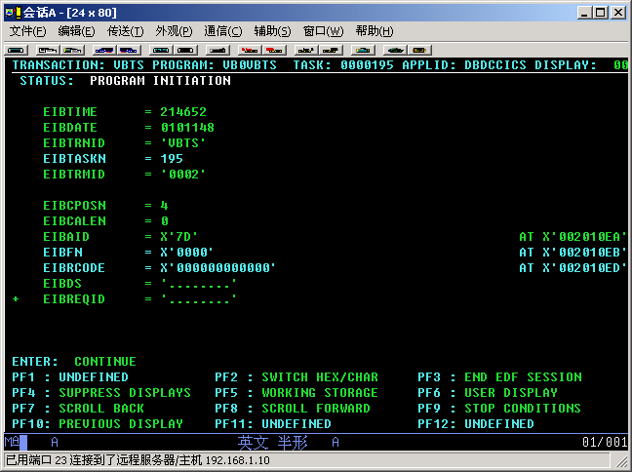

Slide 71
CEDF
启动CEDF交易
  CEDF
  CEDF terminal-id
结束CEDF交易
  PF3
  CEDF OFF

Slide 72
CEDF
PF2
  显示HEX

Slide 73
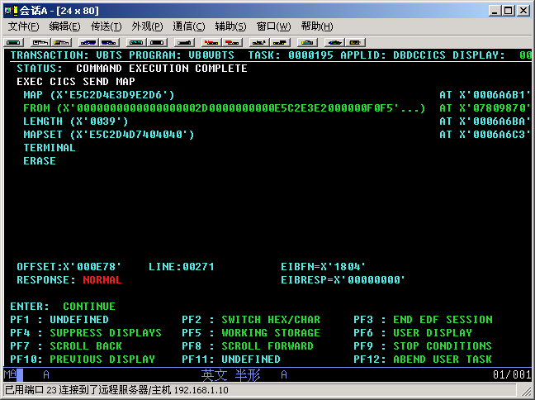

Slide 74
CEDF
PF4
  继续执行程序，直至CICS命令执行错误或到达预先定义的CICS命令
PF9
  设定要监视的CICS命令

Slide 75
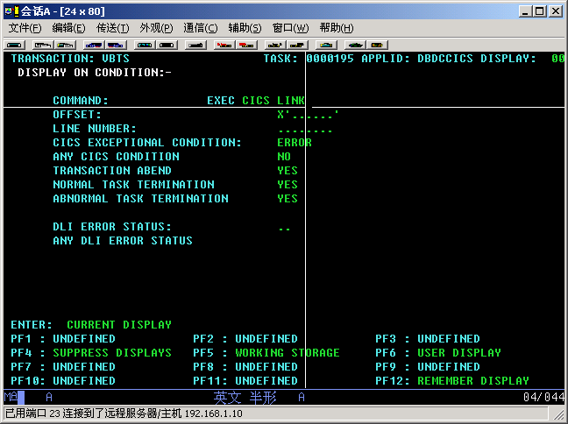

Slide 76
CEDF
PF5
  显示工作区
  执行CECI交易
  PF4
    显示EIB

Slide 77
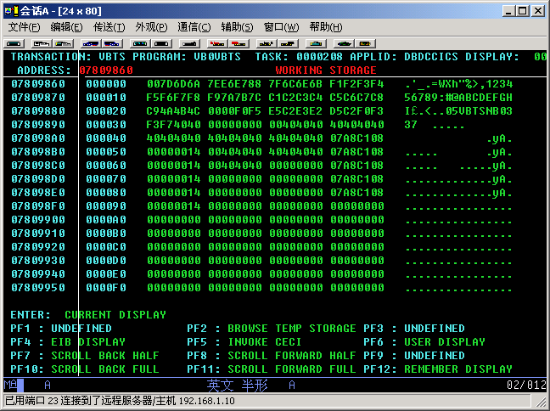

Slide 78
CEDF
PF6
  显示用户画面

Slide 79
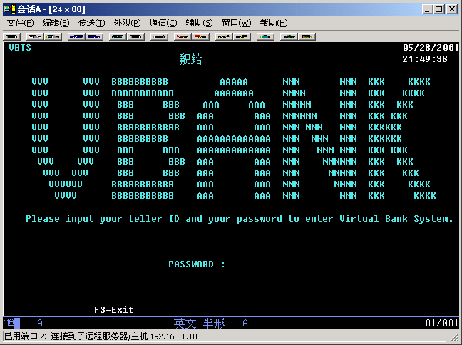

Slide 80
谢谢！

